Slide 1
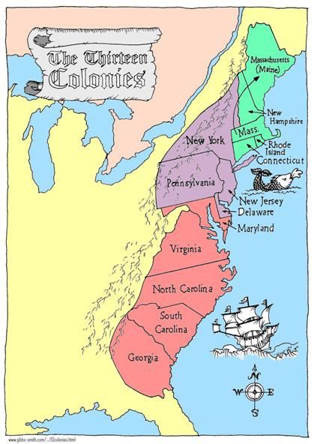
Integrated Literacies Assignment
Gina Groover
SST 309-04

Slide 2
GLCE’s
5-U2.3.2
Describe the daily life of people living in the New England, Middle, and Southern colonies (National Geography Standards 14 and 15, pp.171 and 173)
5-U2.3.3
Describe colonial life in America from the perspectives of at least three different groups of people (e.g., wealthy landowners, farmers, merchants, indentured servants, laborers and the poor, women, enslaved people, free Africans, and American Indians) (National Geography Standard 6, p.154)

Slide 3
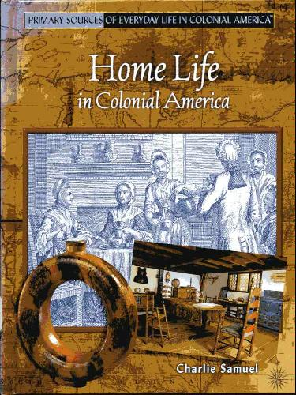
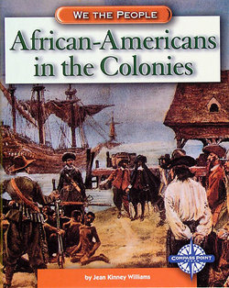
Books
A Day in the Life of a Colonial Schoolteacher
By Kathy Wilmore
Home Life in Colonial America
by Charlie Samuel
African-Americans in the Colonies
By Jean Kinney Williams
A Revolutionary Field Trip
By Susan Katz
The Thirteen Colonies
By Brendan January

Slide 4
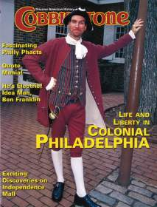
Magazines
Cobblestone
Kids Discover

Slide 5
Websites
http://www.kidinfo.com/american_history/colonization_colonial_life.html
http://library.thinkquest.org/J002611F/
http://www.history.org/
http://www.earlyamerica.com/

Slide 6
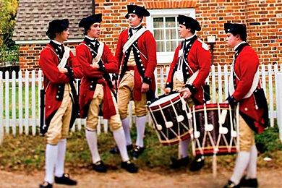
Music
Wolfes Song
http://www.earlyamerica.com/music/WolfesSong.midi
Yankee Doodle Fife & Drum
http://www.youtube.com/watch?v=H85-udAkFa0&feature=related
Colonial Williamsburg Tavern Music
http://www.youtube.com/watch?v=MjNOPDVgjYw

Slide 7
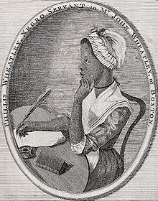
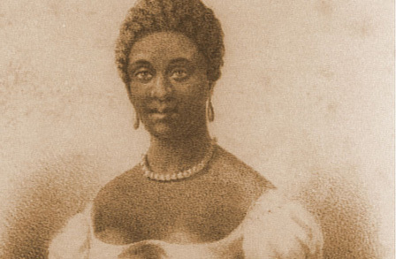
Poetry
On Being Brought from Africa to America
'Twas mercy brought me from my Pagan land, Taught my benighted soul to understand That there's a God, that there's a Saviour too: Once I redemption neither sought nor knew. Some view our sable race with scornful eye, "Their colour is a diabolic die." Remember, Christians, Negro's, black as Cain, May be refin'd, and join th' angelic train.
~Phillis Wheatley, African slave in Boston

Slide 8
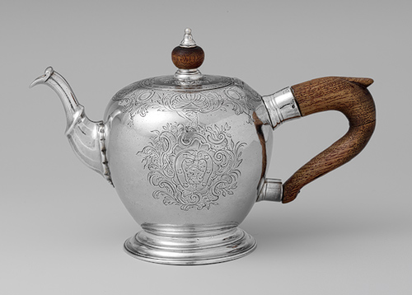
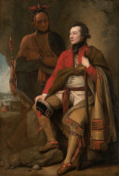
Artwork
Silver Teapot, 1745-55, Josiah Austin
Colonel Guy Johnson and Karonghyontye (Captain David Hill), 1776, Benjamin West
Isaac Winslow and His Family, 1755, Joseph Blackburn

Slide 9
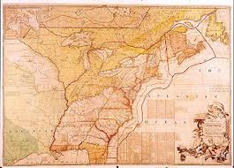
Primary Source Documents
Map of the thirteen colonies
The Pennsylvania Gazette, Jan. 2, 1750

Slide 10
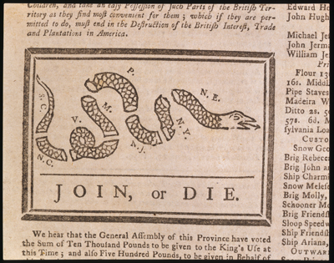
Ad in The Boston News-Letter,
May, 1761
Political Cartoon, Ben Franklin, 1754
Images courtesy of Archiving Early America, http://www.earlyamerica.com

Slide 11
Bibliography
Archiving Early America. (2012, September 15). Retrieved from Early America: http://www.earlyamerica.com/
Colonial America. (2012, September 16). Retrieved from The Dayton Art Institute: http://tours.daytonartinstitute.org/accessart/connect.cfm?TN=da02
Colonial America. (2012, September 15). Retrieved from genconnection: http://www.genconnection.com/English/11/colonialamerica.html
Colonial Kids. (2012, September 15). Retrieved from ThinkQuest: http://library.thinkquest.org/J002611F/
Colonial Life:Life in Colonial America. (2012, September 15). Retrieved from Kid Info: http://www.kidinfo.com/american_history/colonization_colonial_life.html
Colonial Williamsburg. (2012, September 15). Retrieved from Colonial Williamsburg: http://www.history.org/
Primary Sources. (2012, September 16). Retrieved from Smithsonian Source: http://www.smithsoniansource.org/display/primarysource/viewdetails.aspx?TopicId=&PrimarySourceId=1004
Teapot, 1745-55, Josiah Austin. (2012, September 14). Retrieved from The Metropolitan Museum of Art: http://www.metmuseum.org/toah/works-of-art/24.109.7
The Collection. (2012, September 17). Retrieved from National Gallery of Art: http://www.nga.gov/collection/gallery/gg62/gg62-569.html
Wheatley, P. (2012, September 17). On Being Brought from Africa to America. Retrieved from The Poetry Foundation: http://www.poetryfoundation.org/poem/174733
Yankee Doodle Fife and Drum. (2012, September 14). Retrieved from YouTube: http://www.youtube.com/watch?v=H85-udAkFa0&feature=related

